Slide 1

RISK AND RESILIENCE BOOTCAMP
4
Notes:
https://www.ncsc.gov.uk/static-assets/documents/PwnedPasswordsTop100k.txt

Slide 2


Slide 3
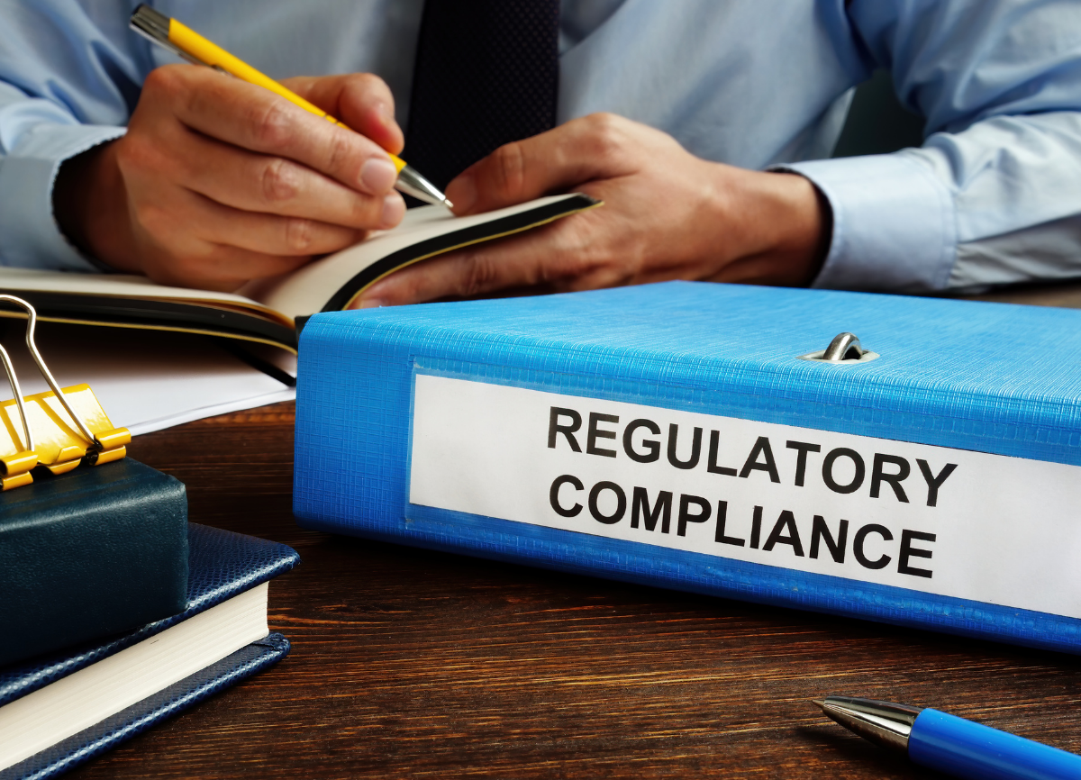
Governance, Audit, and Compliance Basics
This section is an introduction to governance, audit and compliance
In a later module will do a deep dive into compliance issues
Topics introduced
Governance at the organizational level
The role of the audit function
Compliance at the regulatory level

Slide 4
governance
How leadership directs, oversees, and holds IT accountable for supporting business goals, managing risk, and complying with laws
In practice
Sets direction: Board and executives set risk appetite and resilience objectives
Evaluates: Review reports, audits, metrics, for example: KRIs, KPIs, BIAs, recovery tests
Monitors: Ensure controls are working and improvements are made
ISACA’s COBIT model:
Governance objectives are Evaluate, Direct, Monitor (EDM)
Oversight examiners expect banks to provide evidence of these activities

Slide 5
Audit
Independent review that verifies whether controls and processes are working as intended
Types of audits in banking IT
Internal audit
Continuous review of IT risk and resilience processes by the organization
External audit/regulatory exams
For example: OCC, FDIC, or Federal Reserve reviews of IT risk governance and resilience testing
DRI best practice alignment
Post-incident assessments and regular resilience plan exercises are “mini-audits” of readiness
An audit is feedback and assurance that governance processes are real, not just on paper

Slide 6
Compliance
Demonstrating that IT risk and resilience practices follow laws, regulations, and industry standards
In US banks, this includes
Regulators: OCC, FDIC, Federal Reserve, FFIEC (exam guidance)
Standards: NIST CSF, ISO 27001, PCI DSS, SOX (ITGCs)
Banking reporting expectations
Business Continuity Plans (BCPs),
Disaster Recovery Plans (DRPs),
Vendor risk management
Evidence of annual testing and updates.

Slide 7
Compliance
ISACA guidance
Align IT risk management with enterprise risk management (ERM) and regulatory obligations
DRI guidance
Ensure BCPs/DRPs are tested, documented, and regularly improved

Slide 8
interrelationships
Governance sets the rules
Tone at the top, appetite, accountability
Compliance enforces the rules
Ensures the organization is following the applicable laws and frameworks
Audit verifies the rules
Ensures controls are effective and that evidence is available
Together, they create a resilience loop
Leadership defines objectives
Teams execute and maintain controls
Auditors validate, regulators examine
Feedback cycles back into governance decisions

Slide 9
What regulators do
Set the rules (prudence and conduct)
Capital/liquidity, governance, operational resilience, cybersecurity, disclosures, fair dealing
Supervise and examine
Ongoing reviews of controls, testing, and governance
Issue findings and identify areas where remediation is necessary
Enforce
Fines, consent orders, restrictions when rules are broken

Slide 10
What regulators do
Monitor systemic risk
Risks that could threaten the stability of an entire system, not just a single organization
Protect consumers/investors
Ensure products are fair, disclosures are clear, and complaints are handled
Ensure market integrity
Prevent manipulation/abuse in trading and derivatives other markets
Enable orderly failure
Plan for resolution so critical services continue if an organization fails

Slide 11
IT bank regulation
Complicating the discussion of regulation in bank IT systems are the overlapping areas of regulation related to IT systems
Financial industry regulators
Organizations that regulate financial services
Their regulations are not IT specific
For example: audit requirement and record keeping
Generally implemented by IT which supplies the supporting infrastructure
Technology regulators
Not concerned specifically with banking, but focuses on general IT issues
For example: system security or data privacy and integrity
These are not disjoint classifications

Slide 12
IT bank regulation
This is not going to be an exhaustive discussion
The regulatory landscape constantly adapts to new products, services, technologies, threats and market shifts
Quick partial roll call of industry regulators
Safety and soundness / banking
Federal Reserve (FRB), Office of the Comptroller of the Currency (OCC), Federal Deposit Insurance Corporation (FDIC)
Securities and markets
Securities and Exchange Commission (SEC)
Derivatives
Commodity Futures Trading Commission (CFTC)

Slide 13
IT bank regulation
Quick partial roll call of industry regulators (cont)
Consumer financial protection
Consumer Financial Protection Bureau
Self-regulation (brokers)
Financial Industry Regulatory Authority (FINRA)
States
NYDFS (New York) sets influential cyber/resilience rules
Systemic oversight
Financial Stability Oversight Council (FSOC) coordinates across agencies

Slide 14
IT bank regulation
Regulators areas of focus
Documented risk mitigation controls
Evidence for resilience to be design and testing
Operational resilience requirements
Define critical services, set disruption tolerances (RTO/RPO/MTPD), run realistic exercises, and fix gaps
Cybersecurity and incident governance goals
Detect, respond, and notify on time
For example: 36-hour bank incident notifications
Management of third-party risk
Contract for resilience
For example: RTO/RPO, testing rights, notification windows and monitor vendors/fintechs continuously
Governance and reporting
Require metrics (KRIs), issues, and remediation status
Evidence must be retrievable on demand

Slide 15
IT bank regulation
IT resilience roles responsibilities
Translate business impact into targets (RTO/RPO) that can be reviewed
Keep evidence ready for examination
For example: BIA, test reports, access/backup/restore logs)
Run table-tops and technical drills and close action items with owners according to due dates
Align change, incident, and third-party processes to regulatory expectations so the bank stays safe, compliant, and trusted

Slide 16
Regulator Drill down
Practical map of who regulates (or drives) IT operations for US banks
What each expects from tech, risk, and resilience teams
Prudential bank regulators (core examiners)
Federal Reserve (FRB), OCC, FDIC
Supervise safetyand soundness
Assess IT programs using the FFIEC IT Examination Handbook (e.g., the Business Continuity Management booklet)
Expect governed RTO/RPO targets, exercises, dependency management, and evidence on demand.
36-hour incident-notification rule (Interagency: FRB/OCC/FDIC)
Must notify your primary federal regulator as soon as possible and no later than 36 hours after determining a qualifying “notification incident”
Bank service providers must also notify bank customers promptly.
Build 24×7 thresholds and comms playbooks

Slide 17
Regulator Drill down
Prudential bank regulators (cont)
Third-party risk (Interagency Guidance / FDIC)
Life-cycle oversight of vendors/fintechs
Contracts must embed resilience (RTO/RPO, testing rights, incident notice), with ongoing monitoring and exit planning
Interagency coordination
FFIEC (Federal Financial Institutions Examination Council)
Not a regulator itself, but its IT Examination Handbook playbook is used by examiners
InfoSec, Architecture/Infrastructure/Operations, Business Continuity Management
Artifacts and drills are judged against this planning

Slide 18
24×7 Thresholds
The bank, and its critical service providers
Must define clear triggers that apply around the clock, not just during business hours
Determine when an incident becomes serious enough to
Escalate internally
Notify regulators (e.g., the 36-hour rule)
Alert clients or stakeholders
Invoke continuity or recovery procedures
Examples of 24×7 thresholds:
System outage exceeding X minutes
Cyber incident affecting customer data
Payment failures or transaction delays
Critical vendor disruption
Data corruption or ransomware event
Must be monitored continuously
Regulators expect rapid action anytime risk materializes.

Slide 19
Communication Playbooks
Predefined, documented communication procedures
Outlines who to notify, when, how, and in what order during an incident
A comms playbook typically defines:
Escalation chains, for example: IT → Risk → Legal → Executives
Regulator notification steps, for example: which agency, what info, how fast
Internal announcements, for example: Ops, security, leadership
Customer or partner communications
Templates for emails, calls, and regulatory submissions
24×7 contact rosters
Playbooks are essential for meeting the 36-hour incident notification rule and demonstrating readiness during examinations

Slide 20
Regulator Drill down
Securities/markets
SEC
Requires disclosure of material cybersecurity incidents within four business days on Form 8-K and annual disclosure of cyber risk management, strategy, and governance
FINRA: self-regulator for broker-dealers
Rule 4370 requires a written Business Continuity Plan and annual review
Relevant if you have a broker-dealer in the group
State banking/cyber
NYDFS (New York Department of Financial Services)
Prescriptive cybersecurity regulation (governance, MFA, testing, incident reporting, BCDR)
Widely influential beyond NY

Slide 21
Regulator Drill down
Global standards
Basel Committee: Principles for Operational Resilience
Map critical operations, set disruption tolerances, and test through severe-but-plausible scenarios
US prudential examiners align to these principles for large banks
Industry/technical standards
NIST Cybersecurity Framework
US government guidance that many banks use to structure controls and metrics
Regulators expect coherent mappings from bank policies/standards to frameworks like CSF
PCI DSS v4.x
Regulates protecting payment card data and any systems that could affect it
Requires provable controls and testing

Slide 22
Regulator Drill down
Other regulators
There are other aspects of IT that are regulated that are not finance specific
These include areas like:
Customer rights
Privacy and data stewardship
Reporting of suspicious activity

Slide 23

Q&A and open discussion
Notes:
Now is the time to engage in an interactive Q&A session where you can ask questions, share insights, and clarify any doubts about the topics we have covered so far.
This open discussion is designed to ensure that every participant has the opportunity to voice their thoughts and learn from the collective experience of the group.
Your questions and comments are valuable as they help us identify areas that may need further explanation and enable us to tailor future sessions to your needs.
We encourage you to speak up and contribute to the dialogue, as this interaction is one of the key components of our interactive learning approach.
As the session progresses, take note of any questions or ideas that you would like to revisit, and feel free to share your perspectives with the class.

